Slide 1

ARDUINO RFID DOOR LOCK SYSTEM Design Jury
BENJAMIN APPIAH AMPOMAH (ba387)

Slide 2
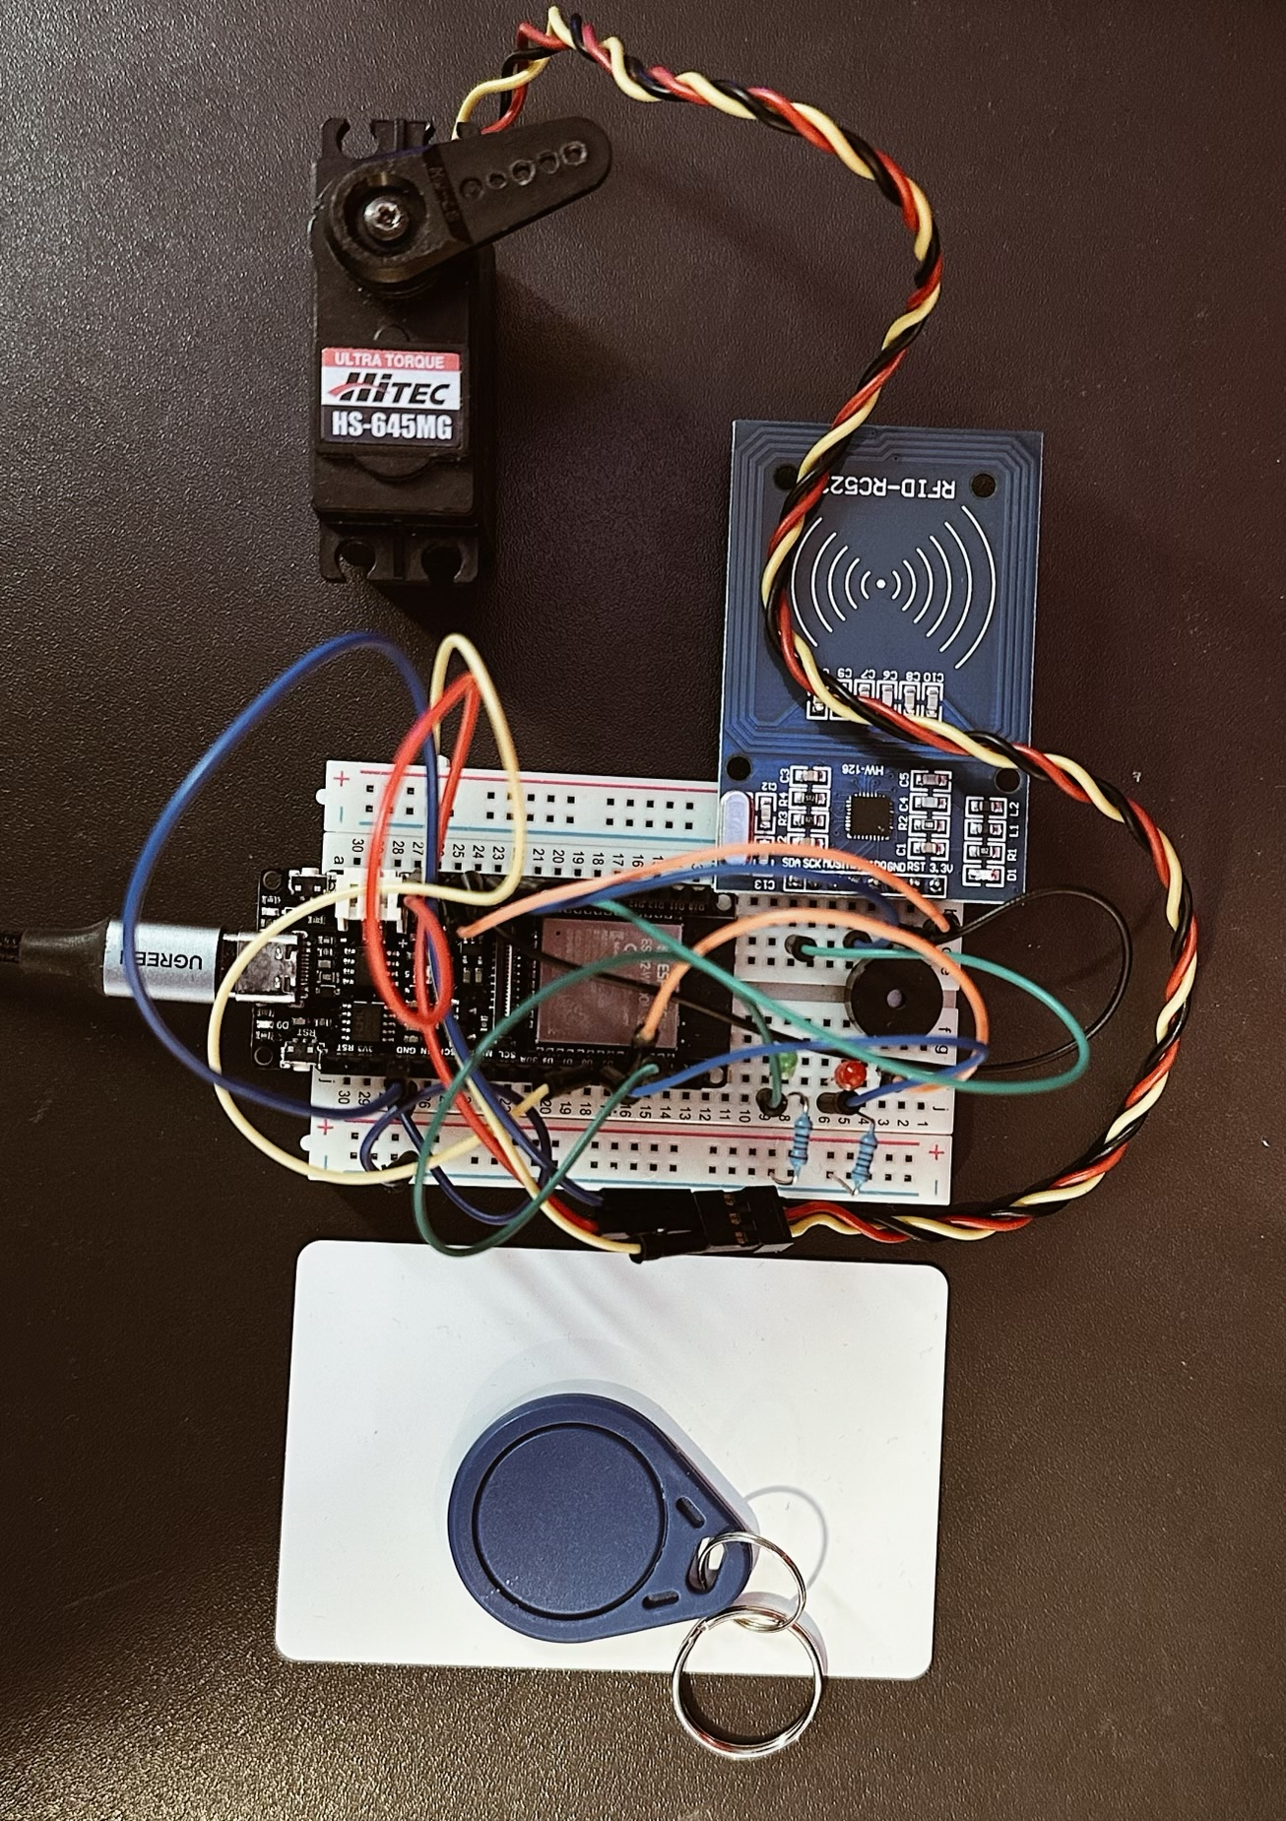
Introduction (Aim and Idea)
This is an RFID door lock mechanism which is based on the Arduino ESP32 and the RC522 RFID sensor, which allows you to use RFID tags or cards to lock and unlock a door.
This project aims to produce a detection and alarm system for homes that use RFID tags connected to the user's phone using WIFI via an Arduino board that sends notifications to determine if they have access or not.
This will be of great value to user as it very convenient and provides security.

Slide 3
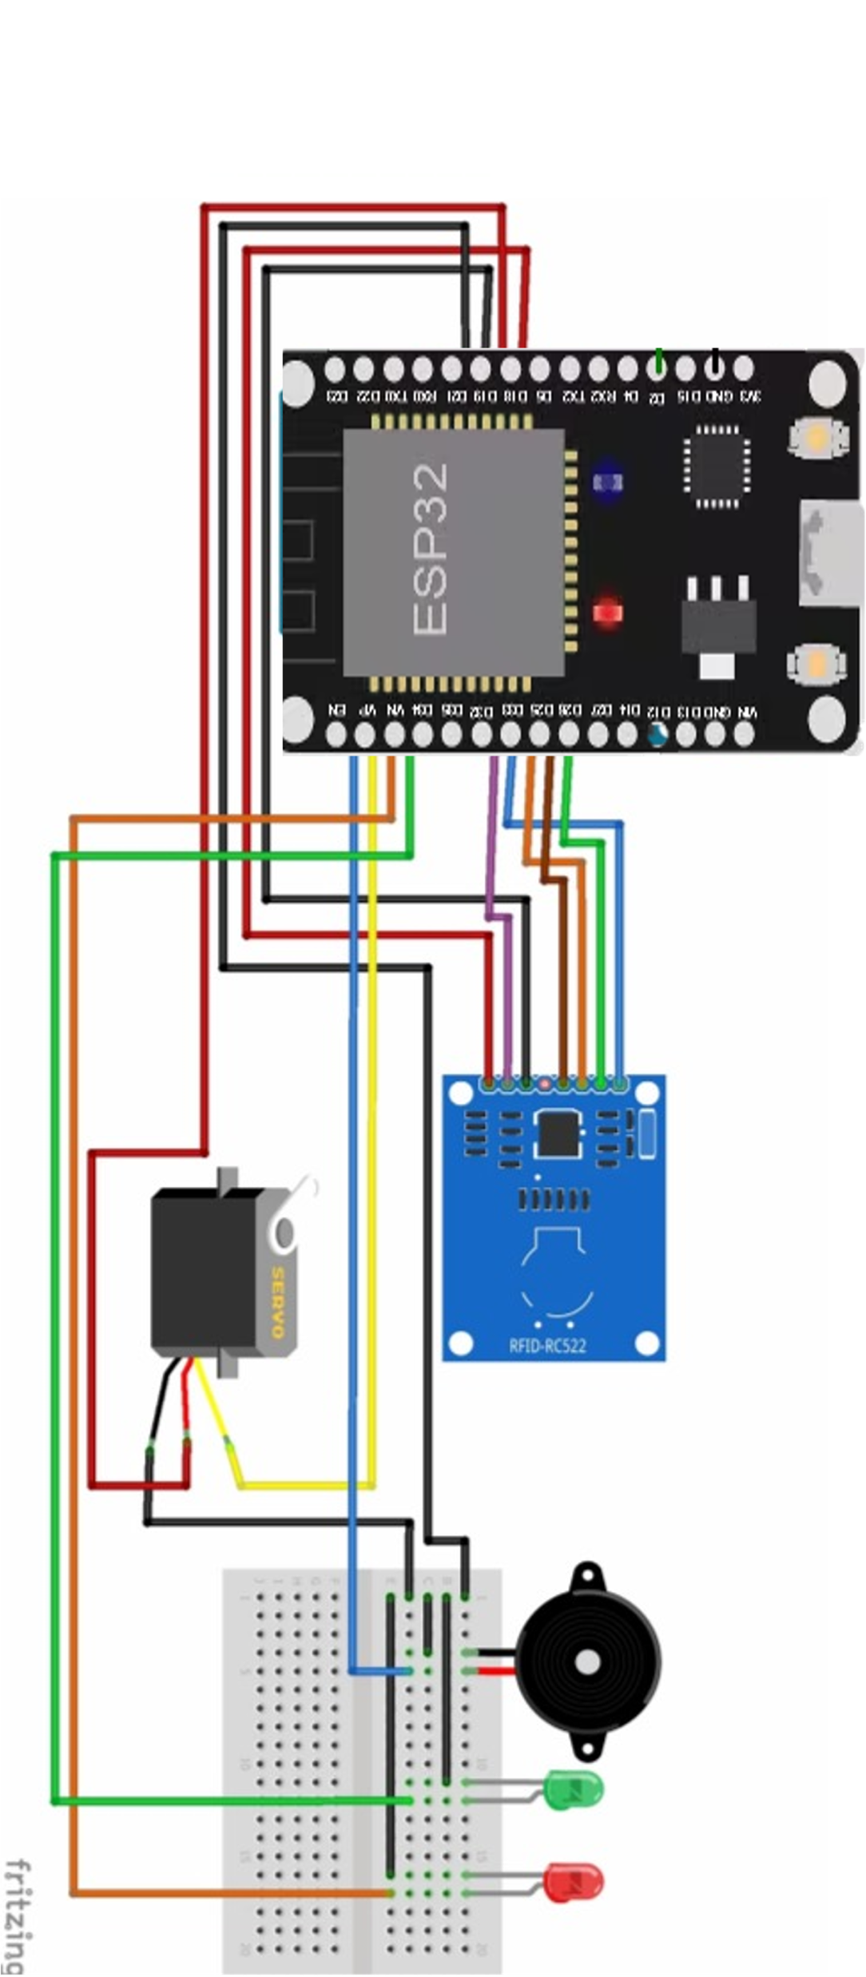
Circuit Diagram
The circuit diagram for the RFID door lock is relatively simple.. It includes the Arduino ESP32 connected to the RC522 RFID Sensor, a Micro Servo, and LEDs.
What You Need To Make Your Own Arduino Based RFID Lock: Arduino Power Supply, RC522 RFID Sensor, Breadboard & Jumpers for Testing, Micro Servo, 2 x LEDs, 2 x 220Ω Resistors

Slide 4
How it works
PROGRESS AND DEVELOPMENT
Even though the IoT project has not been fully completed to the finest stage I believe that I have made significant progress and development.
However, there are some features that I believe will better improve the project in the future given more time. Some of these features may include having the UID of every user sent in the notifications, also being able to implement a camera to capture every user when the RFID card and tag is used or scanned.

Slide 5
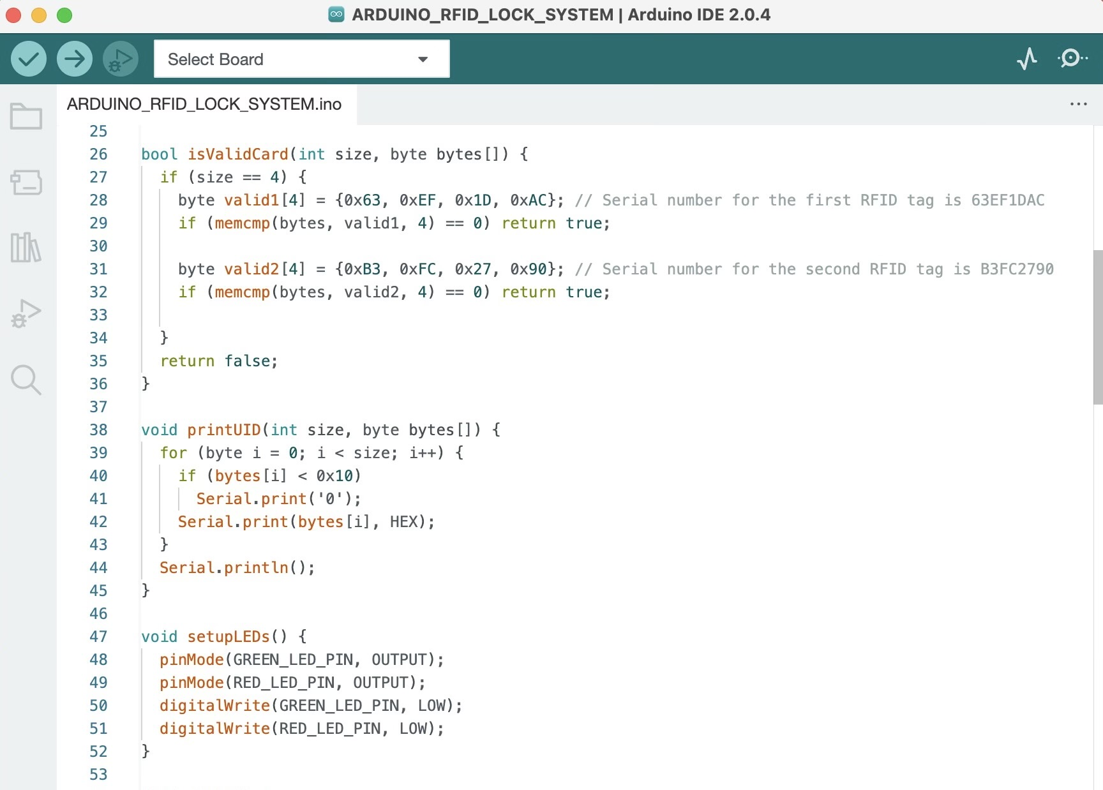
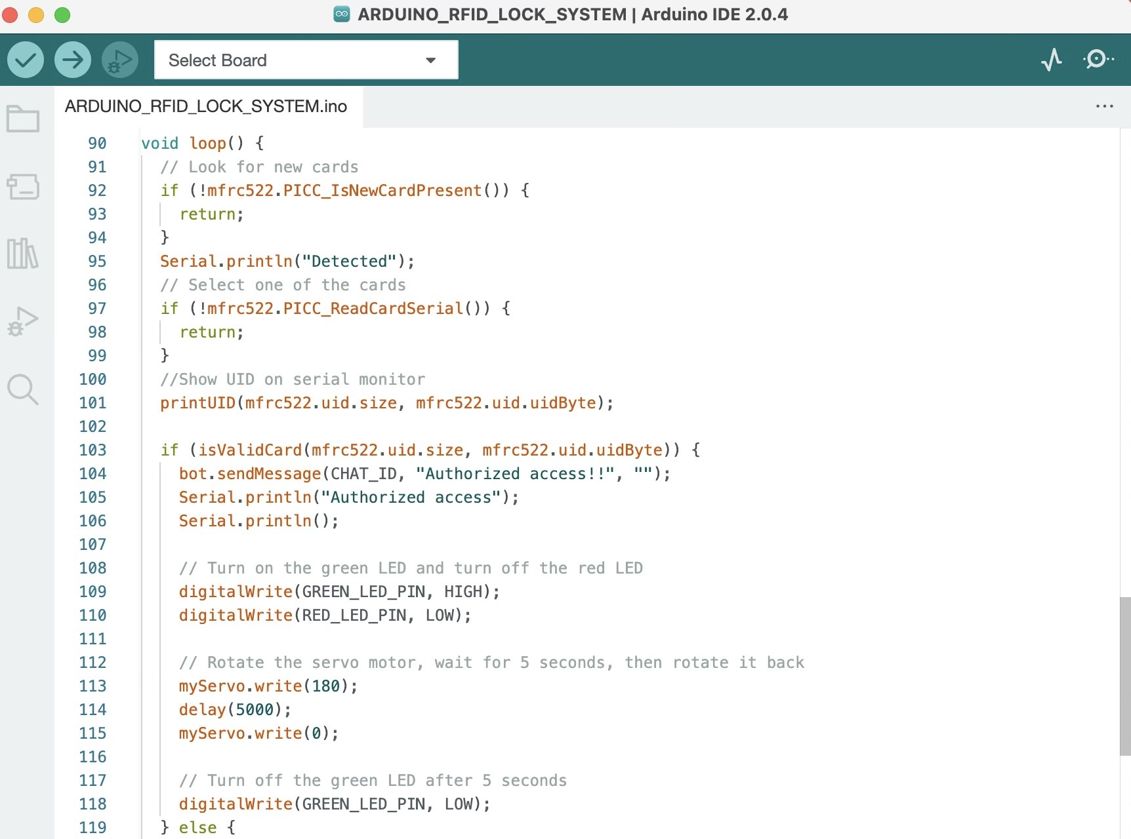
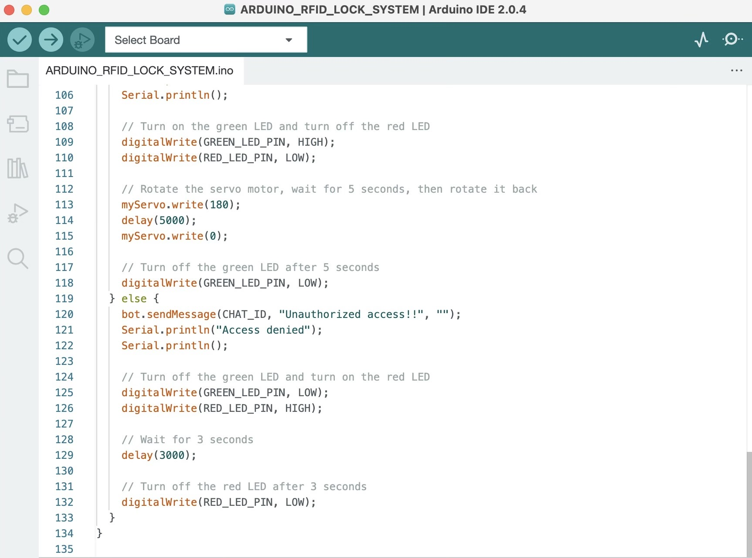
The system uses two LEDs, green and red, to display the access status based on detected RFID cards. When a card is detected, its UID (Unique Identifier) is compared to a hardcoded list of authorized UIDs. If there's a match, access is granted, and the green LED is turned on to indicate authorized access. If there's no match, access is denied, and the red LED is turned on to signal unauthorized access.
For small-scale systems, this method is straightforward and effective. However, in larger systems or situations where the authorized card list may change frequently, it would be more practical to use a flexible data structure or an external database to store and manage authorized UIDs. This approach allows for easier updates and management of authorized cards without needing to modify the code directly, enhancing the system's scalability and adaptability.

Slide 6
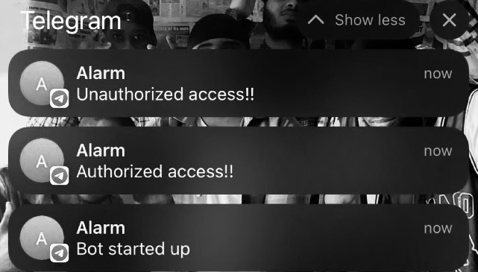
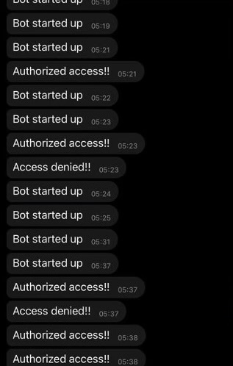
CONT. HOW IT WORKS ( PROGRESS AND DEVELOPMENT)
Detect RFID card using MFRC522 reader.
RFID card detection: The MFRC522 reader scans for cards and sends UIDs to the ESP32.
Check if card UID matches authorized list.
UID validation: The ESP32 checks if the UID matches the authorized list for access
Send access status to Telegram bot.
Telegram notification: The ESP32 sends access status to the Telegram bot for alerts.
Toggle LEDs based on authorization.
LED update: The ESP32 toggles LEDs based on access granted (green) or denied (red).
Control servo motor for lock/unlock.
Servo motor control: The ESP32 unlocks access with authorized cards and locks it after a delay
Repeat process for each detected card.
Continuous detection: The system loops, processing new cards and repeating steps 2-5.

Slide 7
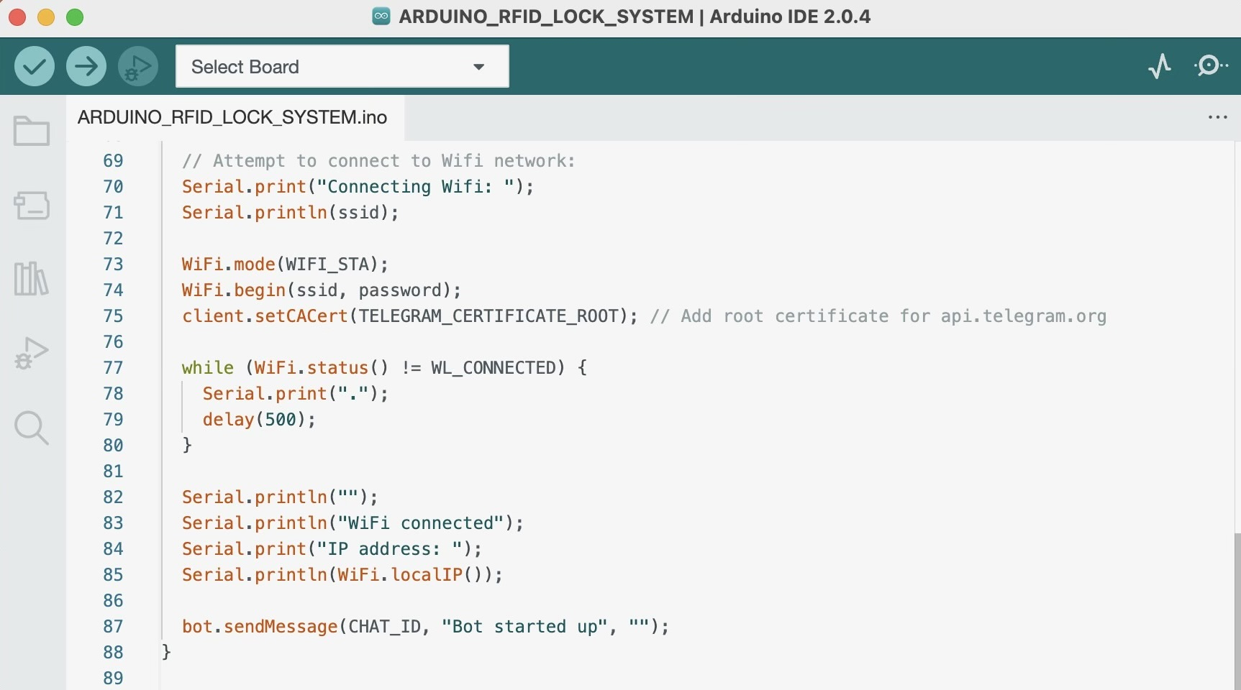
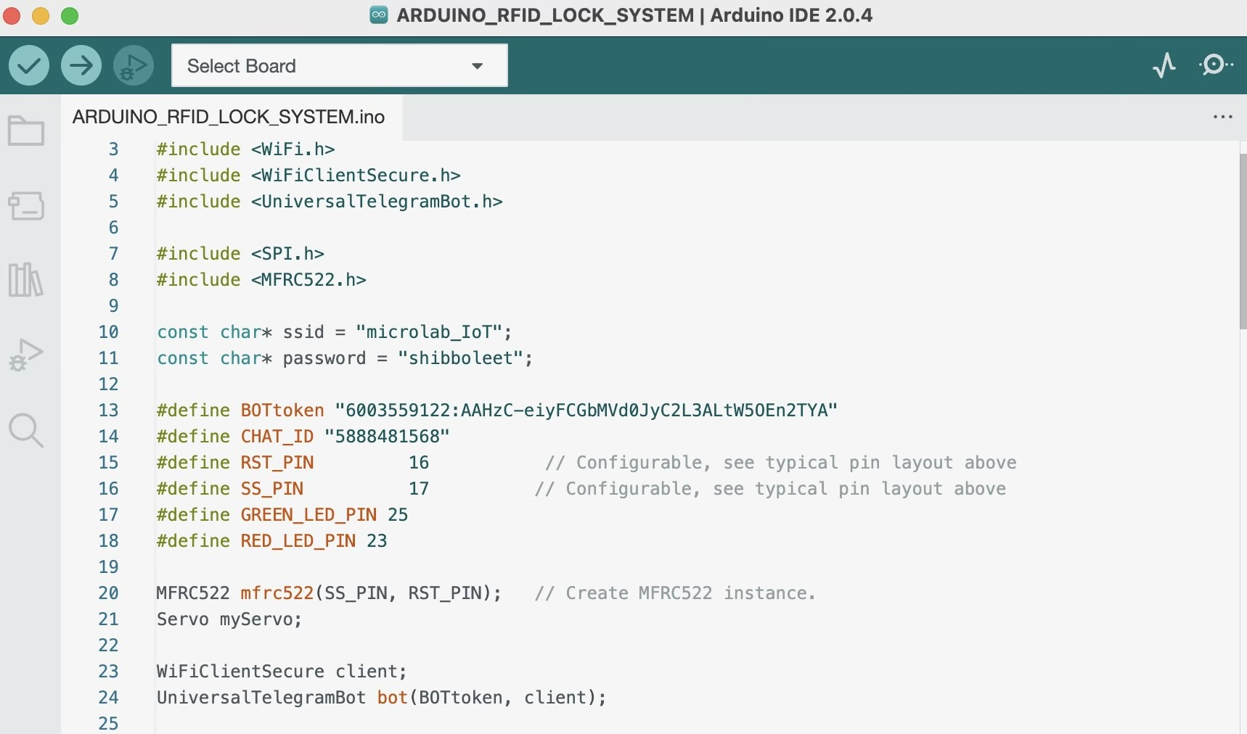
Connectivity
The IoT device uses a Wi-Fi connection via the Arduino board which enables an internet connection allowing notifications to be sent to the user's phone which allows the sensor to detect RFID signals.

Slide 8
Problems Encountered
Throughout the entire duration of my IoT project there were a few difficulties I encountered. Here are the difficulties and how I solved them:
RFID and RFID libraries
At the beginning of my project getting my RFID to work was a major issues which held me back for weeks without progress, this was because the RFID I was using had a library which was incompatible with my ESP23 device.
Also, I got an error while compiling my code “error status 1: library Servo claims to run on avr, megaavr, sam, samd, nrf52, stm32f4, mbed, mbed_nano, mbed_portenta, mbed_rp2040 architecture(s) and may be incompatible with your current board which runs on esp32 architecture(s).”
How I solved this issue
In order to solve this issues, I had to acquire another RFID reader with a compatible library which enabled to proceed with my project effectively.
I included the ESPServo.h library, which provided compatibility for using the servo motor since it is an ESP32 board.
Getting notifications
Another difficulty I had whiles working on connection to the internet and getting notifications on my phone.
How I solved this issue
To solve the this, I had to debug the errors within my code for WIFI connection and try using other notification apps to finally get the right one.
Getting the RFID unique card serial number to detected and show up on the serial monitor.

